Slide 1
ELECTROCART, SHOPPING APPLICATION
UNDER THE GUIDANCE OF :
PRIYANKA KADAM
SUBMITTED BY:
Nishant Patil
Sujal Ugale
Manisha Kanhere
Purva Thale
Divya Mishra
Pooja
Sanjay
Aishwarya

Slide 2
INTRODUCTION
Objective: To build a user-friendly and scalable eCommerce platform.
Scope: Covers product browsing, secure payments, inventory management,
and customer support.
Target Audience: Online shoppers, businesses, and individuals looking
for electronic product.

Slide 3
PROJECT OBJECTIVE
Create a user-friendly, responsive eCommerce website.
Ensure secure payment options and data protection.
Provide seamless navigation and easy product access.
Enhance customer engagement and boost online sales.
Integrate backend systems for automated inventory and
order management.
Expand market reach and improve customer satisfaction.

Slide 4
TECHNOLOGY USED
JAVA
Java is an object-oriented programming (OOP) language, which means it supports the principles and concepts of object-oriented programming.
JaVa
HTML
Angular
HTML, which stands for HyperText Markup Language, is the standard markup language used for creating and structuring web pages.
ANGULAR
Angular is a TypeScript-based framework that uses HTML, CSS, and JavaScript to build robust and scalable single-page applications.
Postman
POSTMAN
JAVASCRIPT
Postman is a popular collaboration platform and toolset used by developers to build, test, and document APIs
JavaScript is a widely used programming language primarily used for web development.

Slide 5
REQUIRED SPECIFICATIONS
HARDWARE CONFIGURATION | SOFTWARE CONFIGURATION
Operating System : Windows 10 and above | Software IDE: Springboot, Postman, MySQL, VS Code.
Hard Disk: 500GB | Language: JAVA, Type Script, HTML, CSS, SQL
RAM: 8 GB | Front End: Angular, Boot Strap
 | Back End: Spring Boot, MySQL.

Slide 6
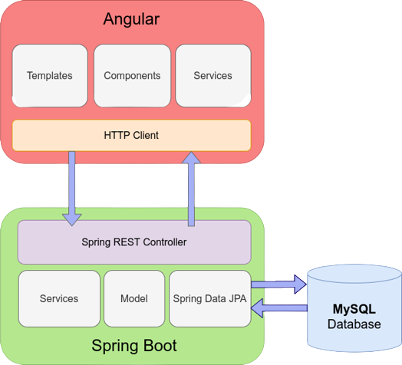
CONNECTION TO DATABASE

Slide 7
MODULES
01
ADMIN :
Register and Login.
02
CUSTOMER :
Register and Login.
03
PRODUCT LIST :
Add/Edit/Delete Electronic items by Admin.
04
CART :
Customer can add Electronic Products from Product list.
05
ORDER :
06
PAYMENT :
Displays items present in customer’s cart and order status.
Customer has to pay for placing of order.

Slide 8
SPRING NOTATATIONS
@Controller : | The @Controller annotation indicates that a particular class serves the role of a controller. Spring Controller annotation is typically used in combination with annotated handler methods based on the @RequestMapping annotation.
@Autowired | The @Autowired annotation provides more fine-grained control over where and how auto-wiring should be accomplished. Autowiring feature of spring framework enables you to inject the object dependency implicitly. It internally uses setter or constructor injection.
@RequestMapping | The @RequestMapping is one of the most common annotation used in Spring Web applications. This annotation maps HTTP requests to handler methods of MVC and REST controllers.
@Entity | The @Entity annotation specifies that the class is an entity and is mapped to a database table.
@Table | The @Table annotation is used to create a table in database.
@JoinColumn | The @JoinColumn is used to specify a column for joining an entity association or element collection.

Slide 9
SPRING NOTATATIONS
@PutMapping | The @PutMapping is used for update the records.
@PostMapping | The @PostMapping is used to create a resource Mapping.
@GetMapping | The @GetMapping is used to read all the inserted records.
@DeleteMapping | The @DeleteMapping is used to delete the records.
@PathVariable | The @Path Variable annotation is used to extract the value from the URL.
@RequestParam | The @RequestParam annotation is used to read the form data and bind it automatically to the parameter present in the provided method.

Slide 10
SPRING NOTATATIONS
@Request Body | The @RequestBody annotation is applicable to handler methods of spring controller. spring should deserialize a request body into an object.
@OneToOne Mapping | The @OneToOne JPA annotation is used to map the source entity with the target entity, Hibernate maps the tables in your database to the Entity classes in your application.
@OneToMany Mapping | The @OneTo-Many relationship between table A and table B indicates that one row in a table A link to many rows in table B but one row in table B links to only one row in table A.
@ManyToOne Mapping | The @Many-to-One mapping means that many instances of this entity are mapped to one instance of another entity.
@ExceptionHandler | The @ExceptionHandler is an annotation used to handle the specific exceptions and sending the custom responses to the client.
@ControllerAdvice | A controller advice allows you to use exactly the same exception handling techniques but apply them across the whole application, not just to an individual controller. You can think of them as an annotation driven interceptor.

Slide 11
ADVANTAGES
REMOTE ORDERING
USER FRIENDLY INTERFACE
Customer can order whenever they want.
This website was designed using angularjs, html ,jss and css which makes it very attarctive and easy to use.
AFFORDABILITY
Time saving & 24*7 availability
This website offers affordable prices and Best in market prices
This website is techsavy time saving and 24*7 available site.

Slide 12
Future Enhancement’s
Add Feedback form for customer.
Improve UI of website
Add shipment tracker
Virtual Tryon
Enhance user profile

Slide 13
CONCLUSION
The online electronic shopping store in Java offers a modern and convenient way for customers to browse, select, and purchase electronic products from the comfort of their homes.
With a comprehensive product catalog and filtering capabilities, and a seamless shopping cart and checkout process, users can easily find and purchase their desired products. By leveraging the power of Java and modern technologies, we have created a robust and scalable platform that meets the needs of today's tech-savvy consumers.

Slide 14
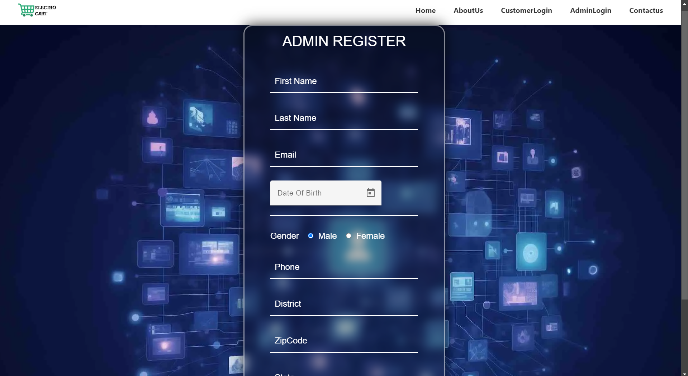
ADMIN REGISTRATION

Slide 15
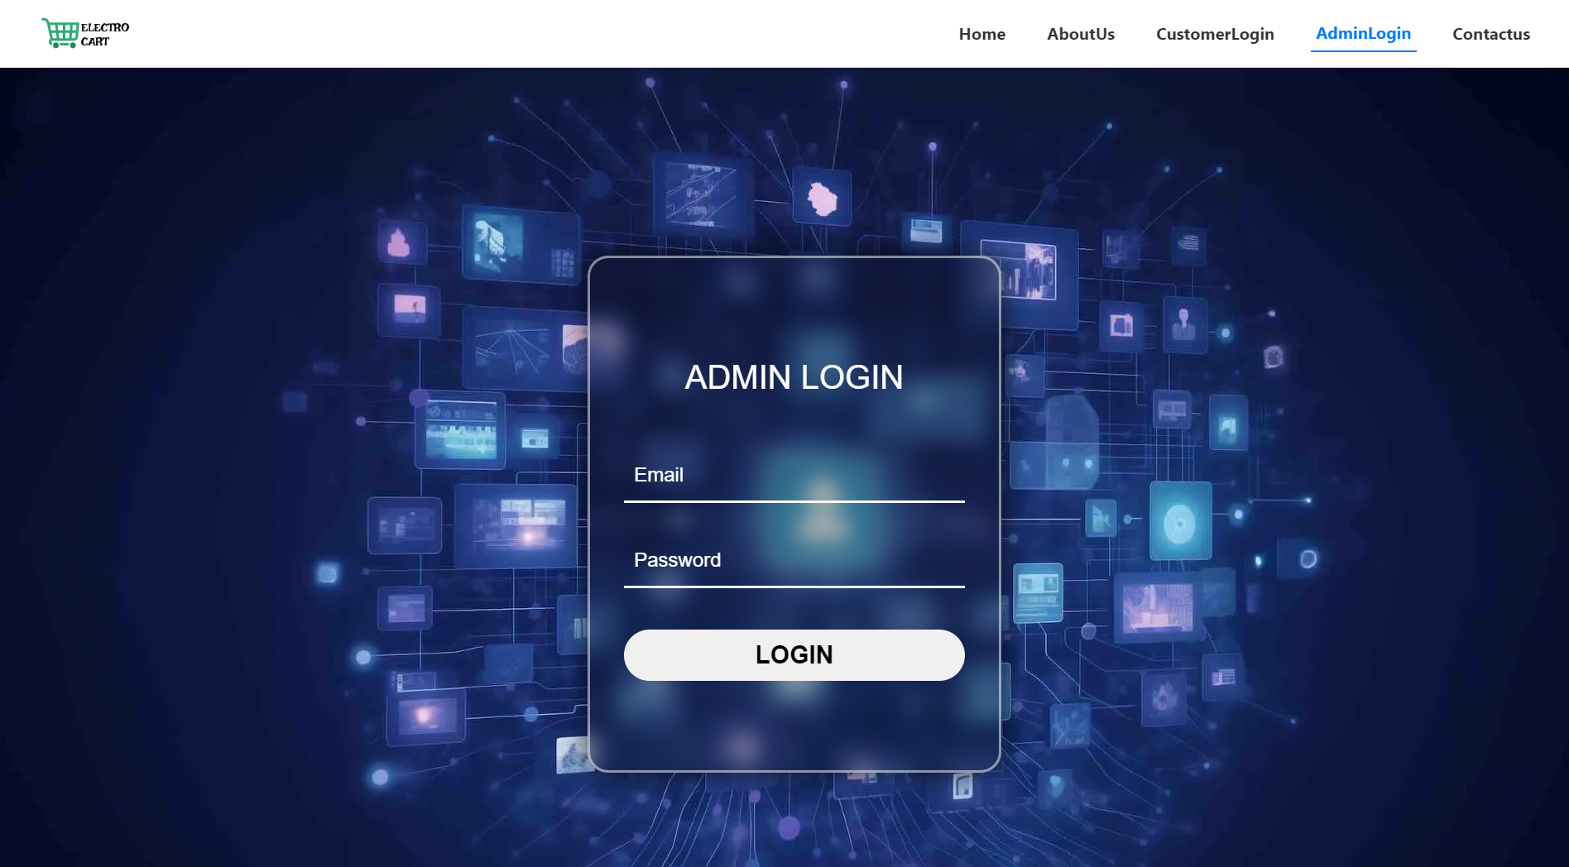
ADMIN SIGNIN

Slide 16
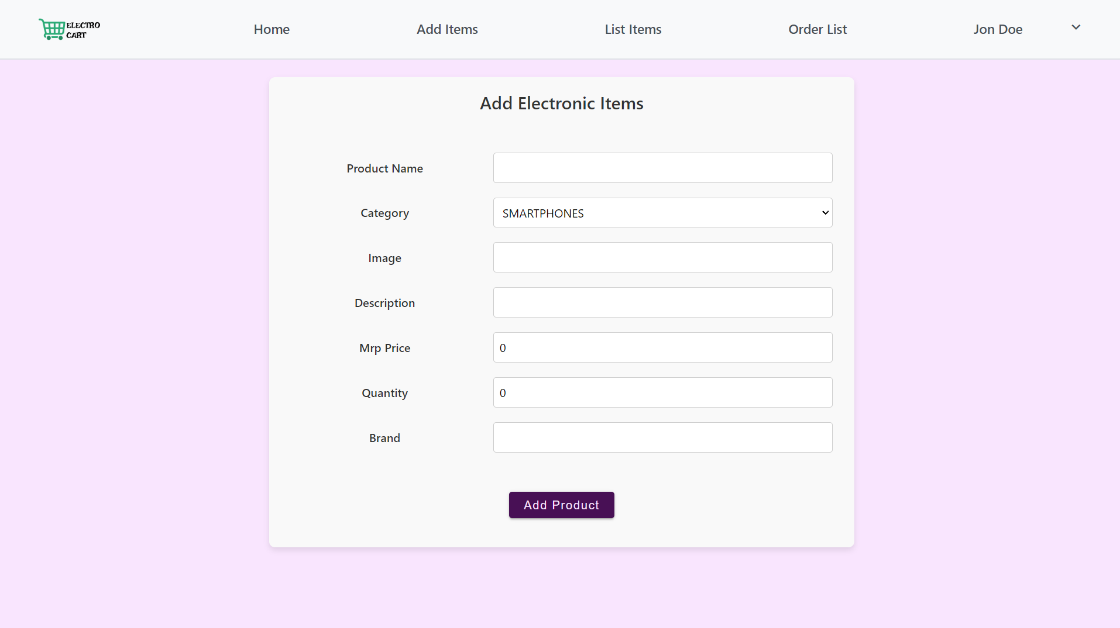
ADD ITEMS FROM ADMIN

Slide 17
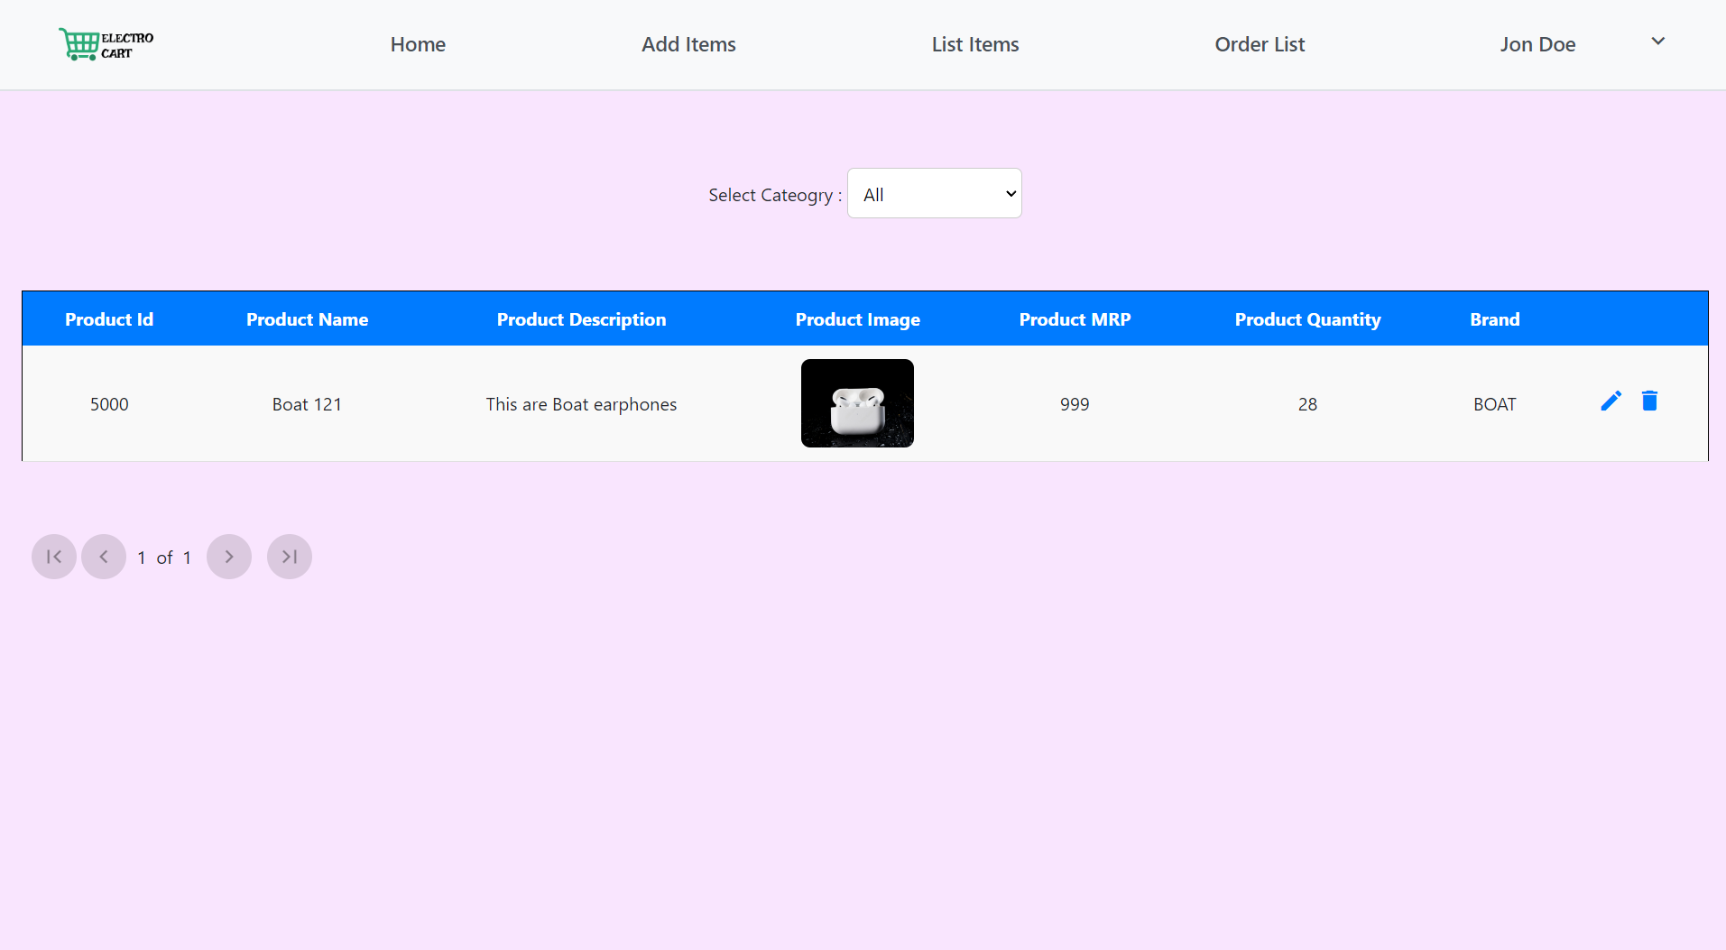
PRODUCT LIST

Slide 18
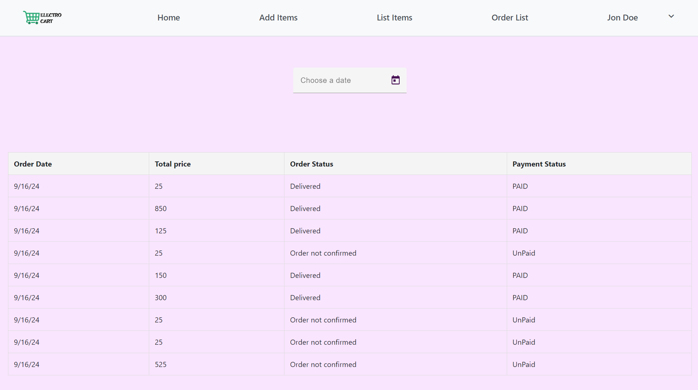
CUSTOMER ORDERS

Slide 19
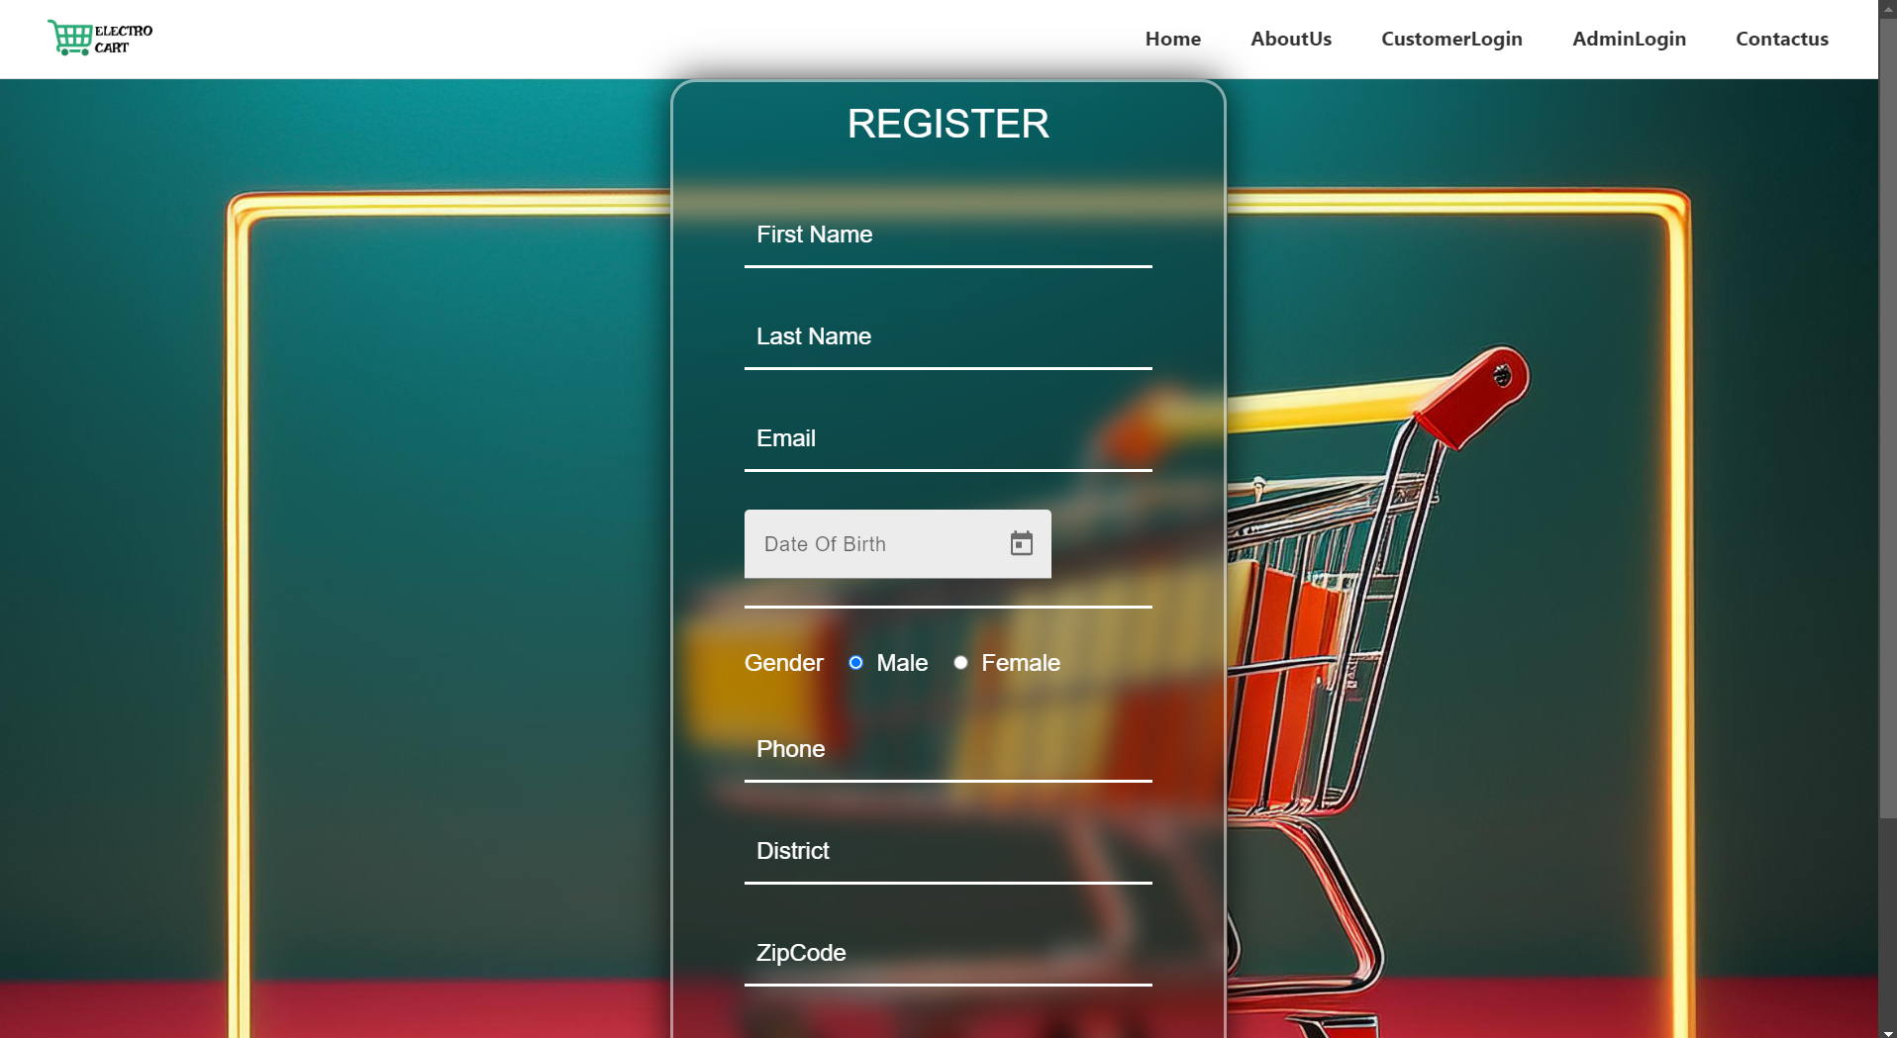
CUSTOMER REGISTRATION

Slide 20
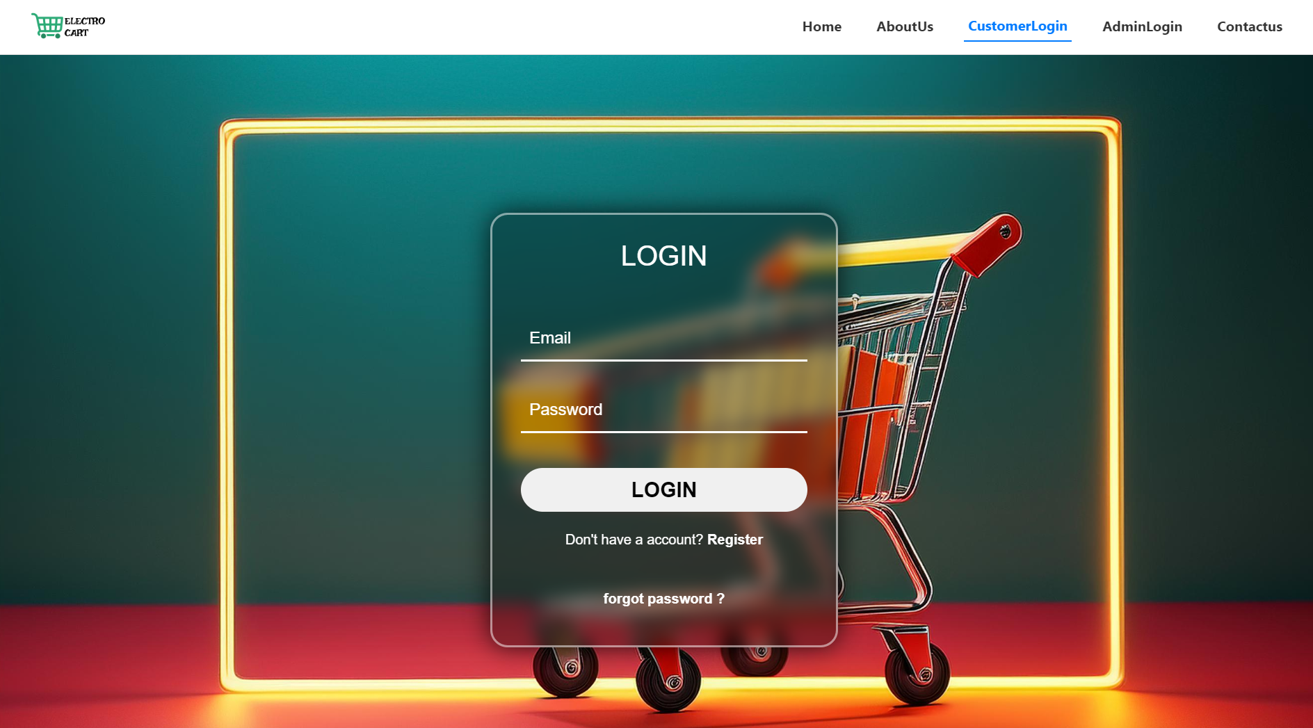
CUSTOMER SIGNIN

Slide 21
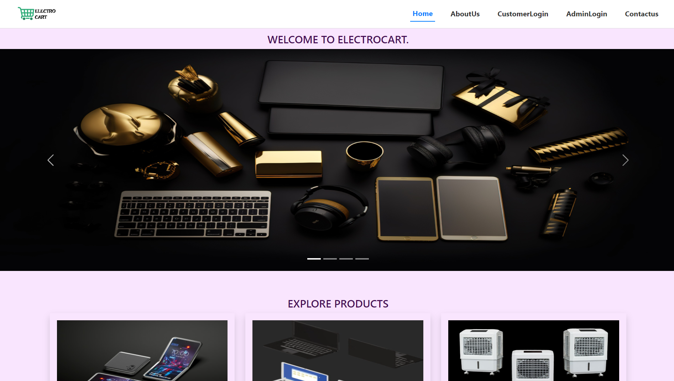
CUSTOMER HOME PAGE

Slide 22
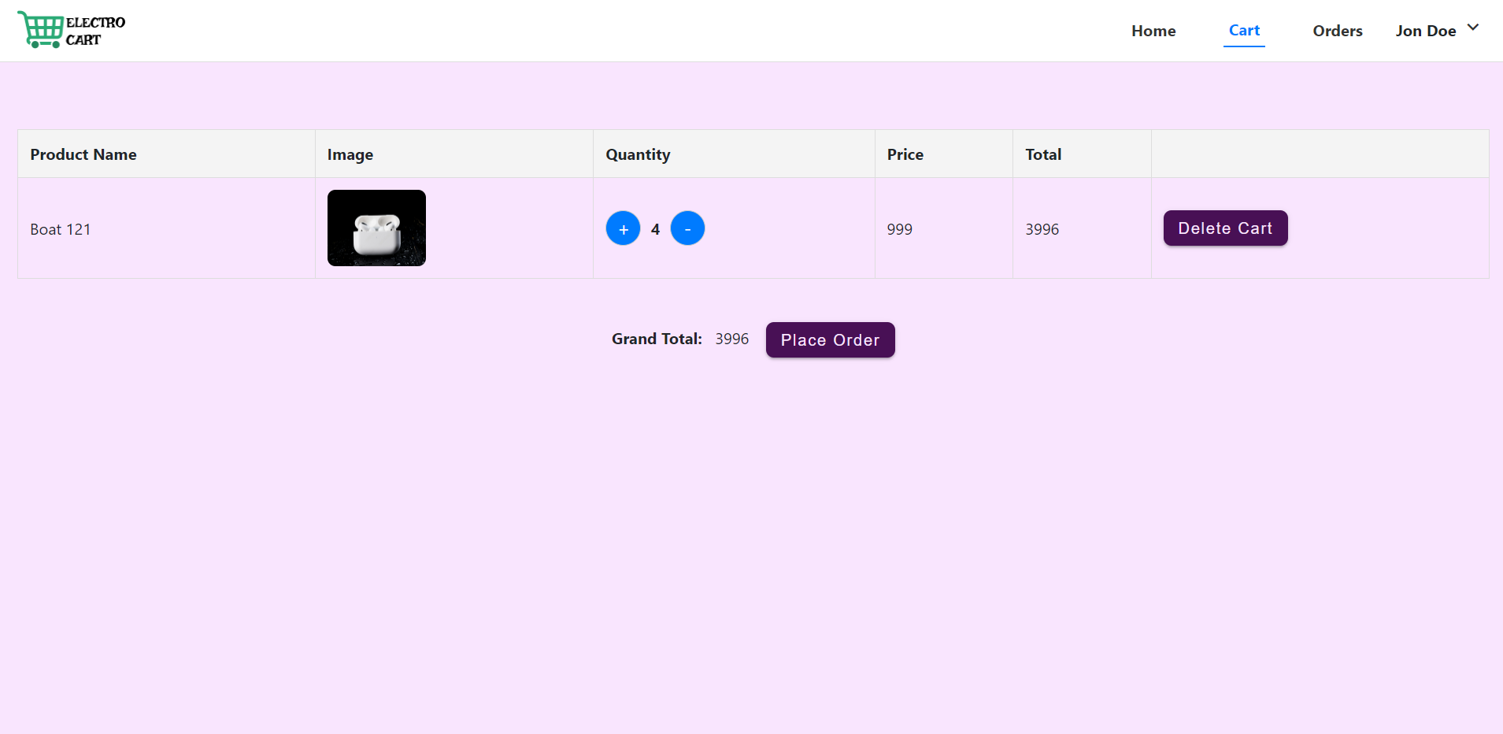
CUSTOMER CART

Slide 23
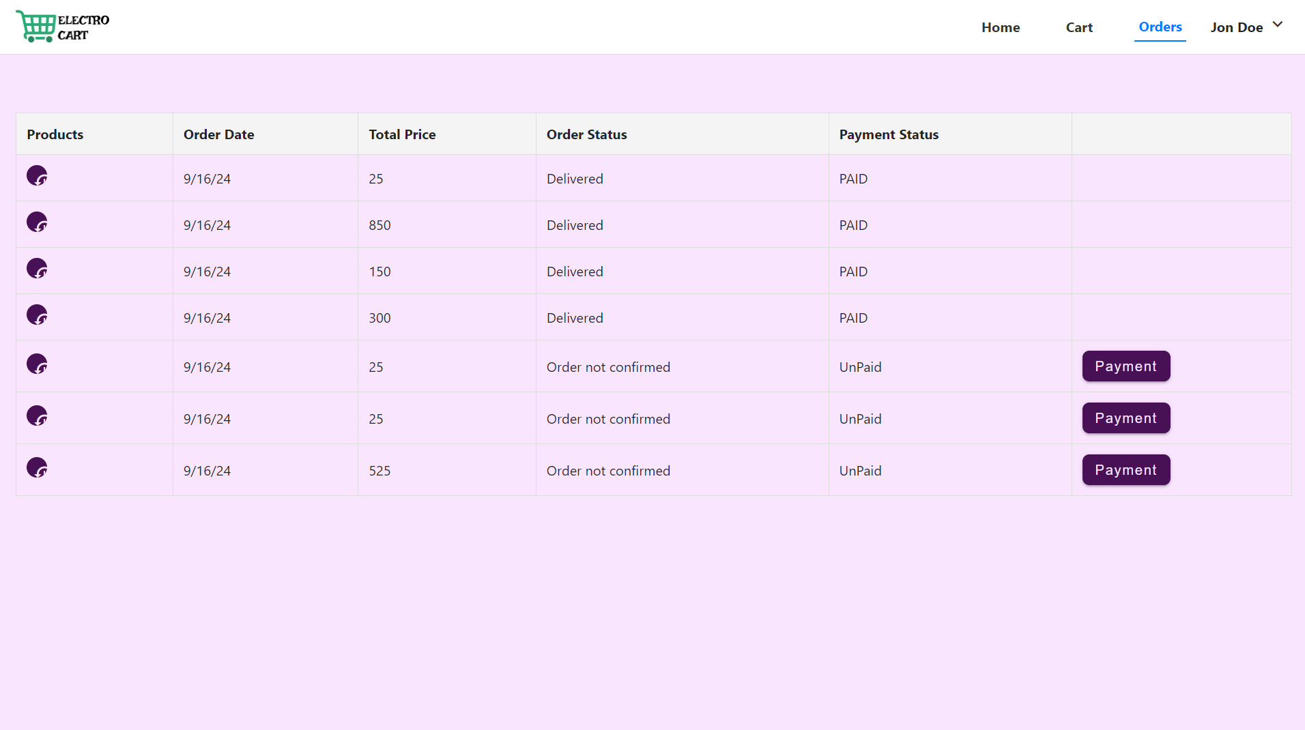
CUSTOMER ORDER STATUS

Slide 24
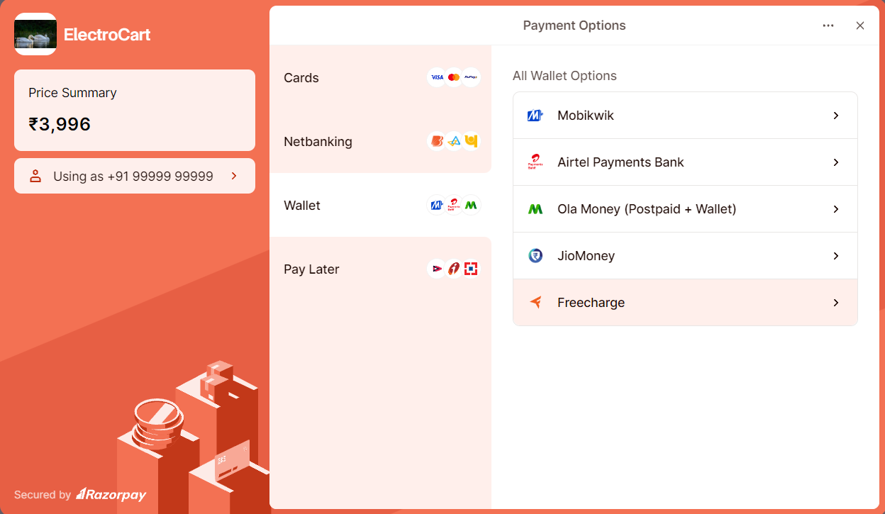
CUSTOMER PAYMENT

Slide 25
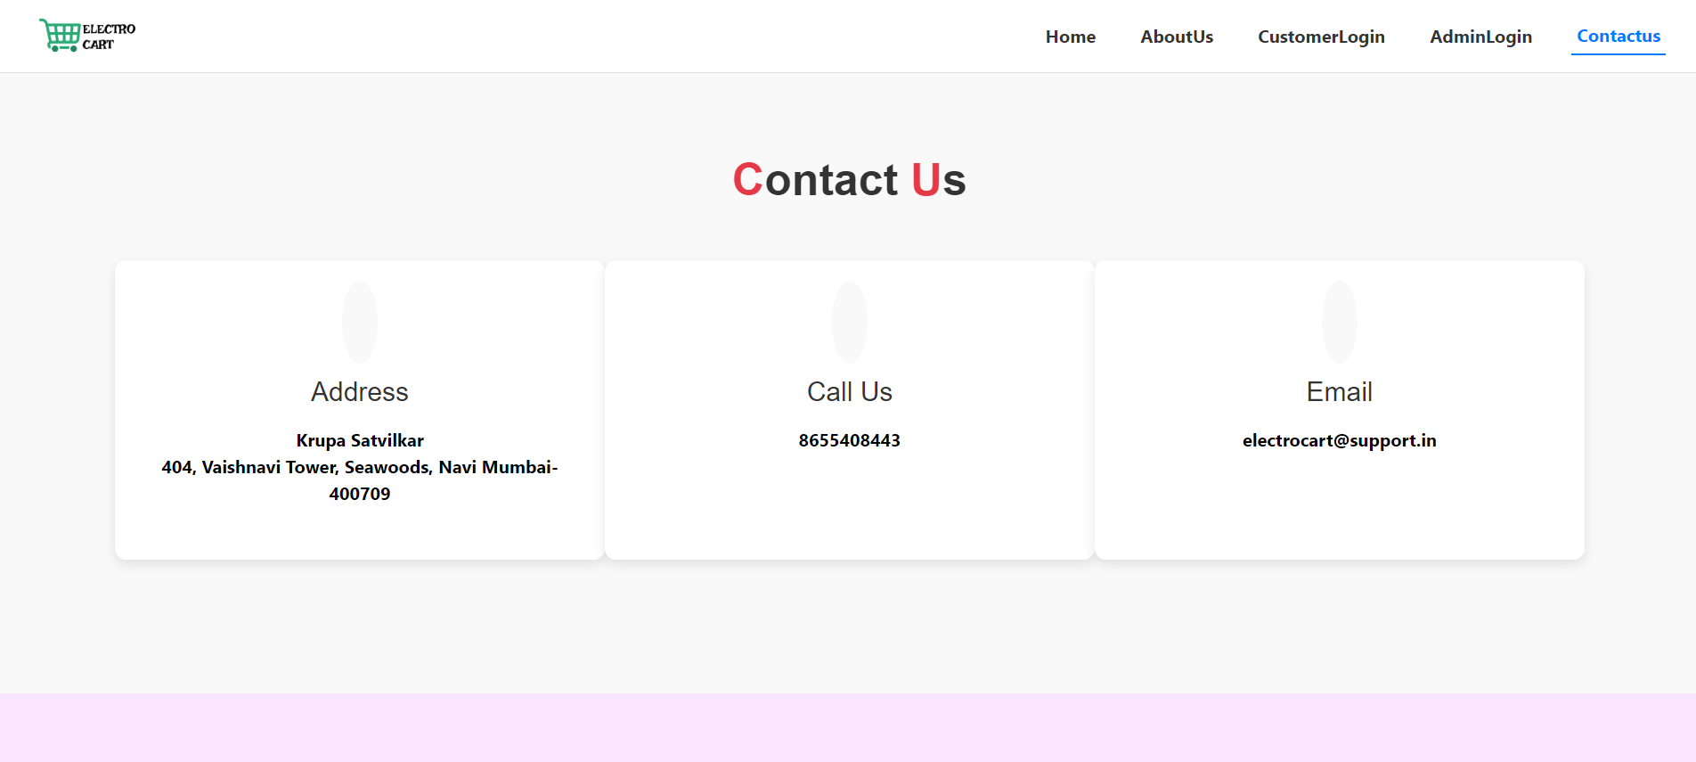
CONTACT US

Slide 26
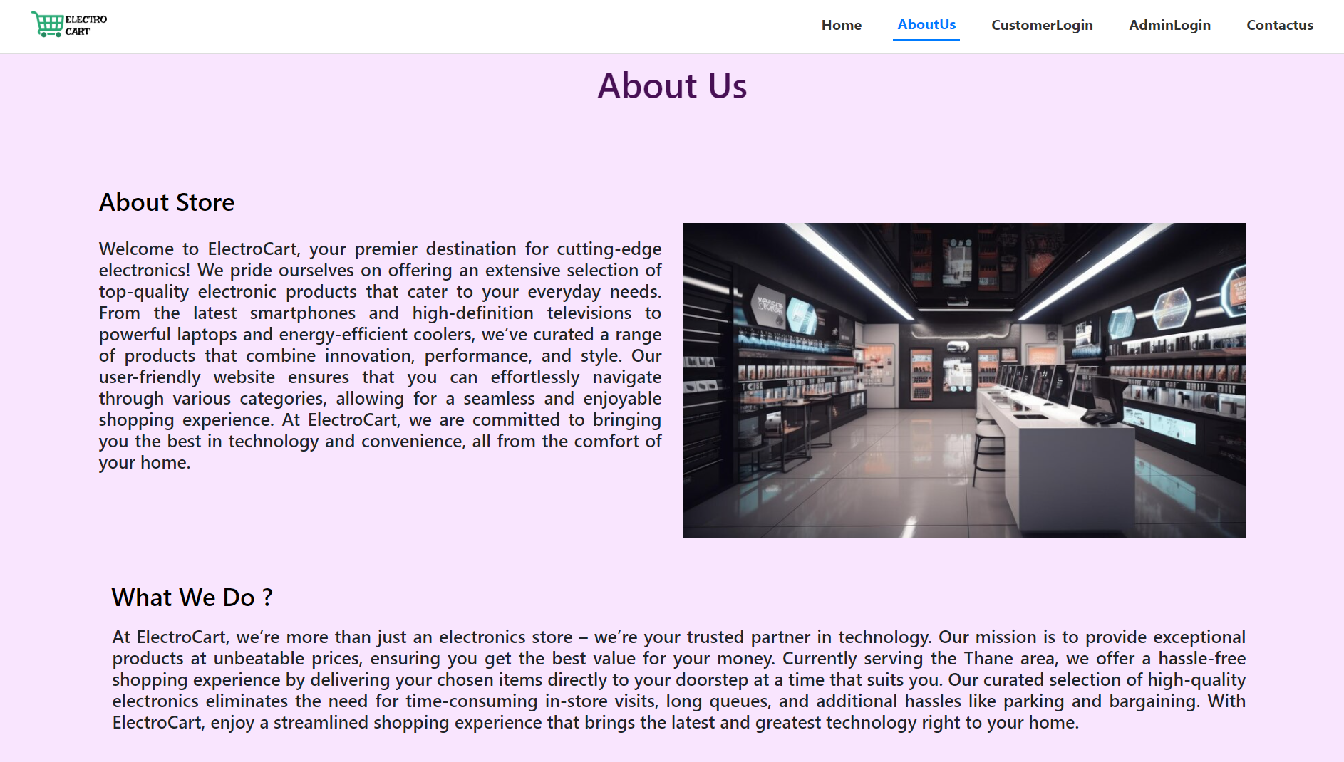
ABOUT US

Slide 27
THANK YOU

